Slide 1
Job Vacancy Data
At the start of March 2020 (W/E 15th), before the main elements of lockdown were announced, advertised vacancies in LCR were running at an average of 12,000 a month.
Over the period March – June, we utilised Institute for Employment Studies data to track the change in vacancies over the lockdown period.
The average low point during May 2020 was around 5,500 vacancies, representing a 54% decline with pre-lockdown figures.
In early July (6th – Present Week) we launched our own internal vacancy dashboard, analysing Adzuna vacancy data.
As of September 21st, vacancies in LCR stood at 7,449 – a 40% drop since pre-lockdown.
1

Slide 2
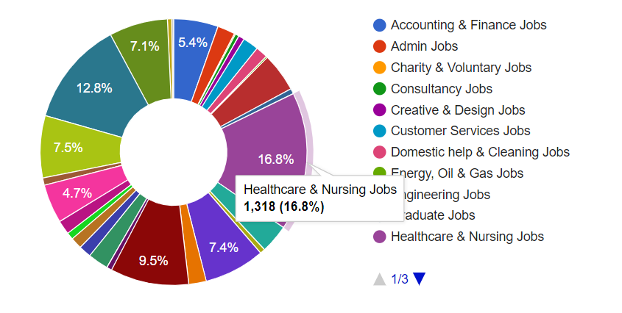
Job Vacancy Data – Sector Changes
Utilising Adzuna Sector Categories, we are able to chart the rise and fall of vacancies across a variety of industries.
Over the last 10 weeks, the five largest sector increases across the city region on average have been in
Logistics & Warehousing [+528 roles]
Trade & Construction [+309 roles]
Sales [+206 roles]
Healthcare & Nursing [+201 roles]
I.T [+195 roles]
These sectors are then closely followed by increases in Engineering Jobs, Hospitality & Catering and Manufacturing Jobs.
In terms of actual volume of vacancies – Healthcare & Nursing lead with 16.8% (1,318), followed by Teaching 12.8% (1,000), Logistics & Warehouse 9.5% (747), Social Work 7.5% (590) and IT Jobs 7.4% (578).
2

Slide 3
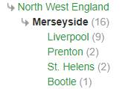
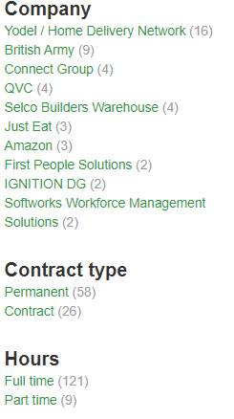
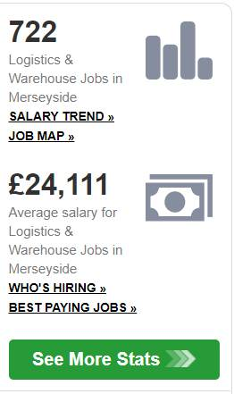
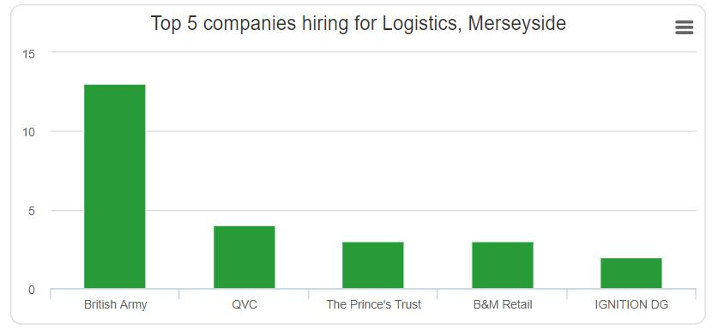
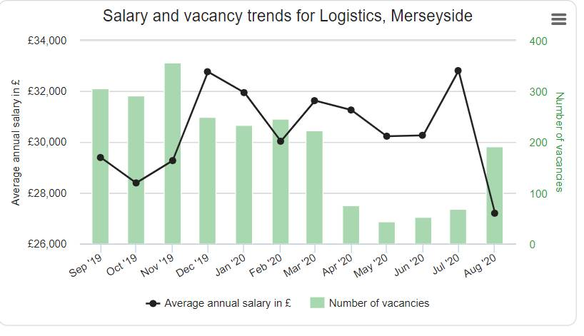
Job Vacancy Data – Potential Sector Insights [Logistics & Warehouse Roles]
3

Slide 4
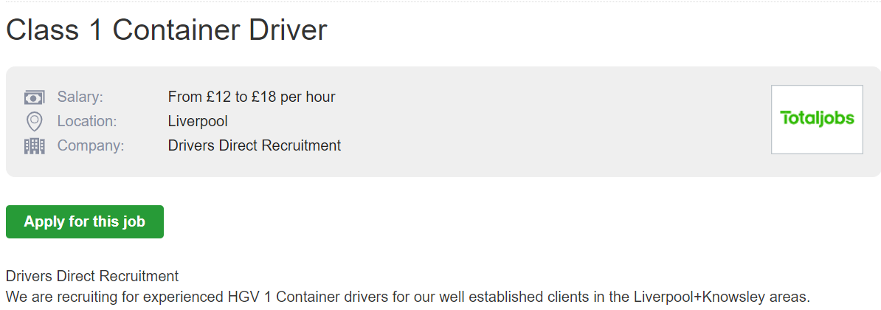
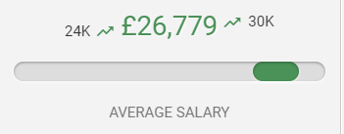
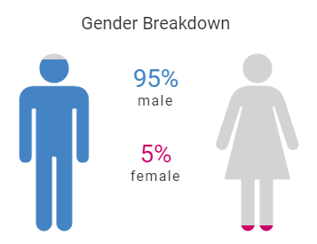
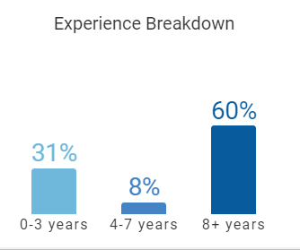
Job Vacancy Data – Potential Sector Insights Case Study [1]
Class 1 HGV DRIVER
Skills & Knowledge
Haulage
Class 1 License
Driving
Account Management
Legislation
Operations
Fuel
Documenting
Safety
Each individual job pulled from Adzuna has a short amount of details within the vacancy which can be manually extracted, however this is often not enough to determine the average skills within a role.
Using Horsefly Analytics, we can narrow down a sample of a set role, in this instance ‘Class 1 Container Driver/Class 1 HGV Driver’ to further extract key skills/progression pathways and other associated data [e.g.: Gender Split/Experience Levels/Salaries/Companies]
4

Slide 5
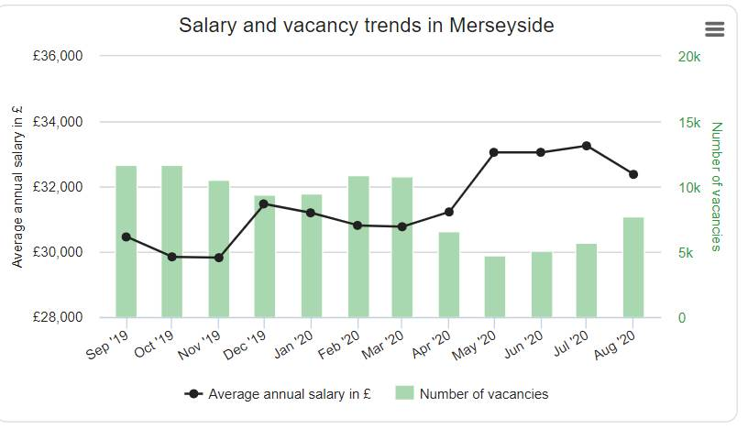
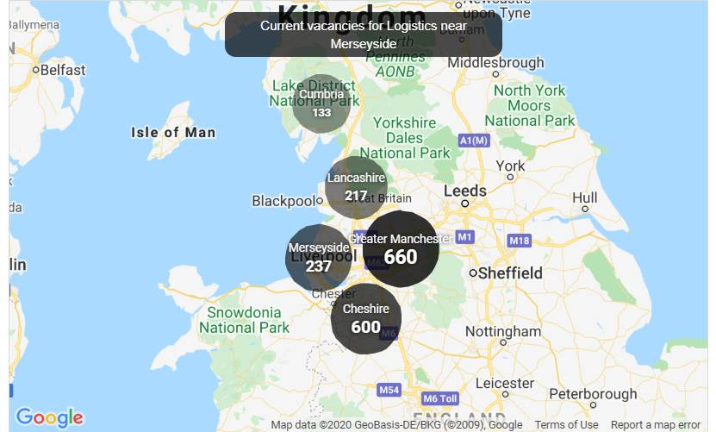
Job Vacancy Data
Utilising Adzuna’s built in statistics service, we are able to access a range of other data, including:
Number of vacancies in local areas [Greater Manchester etc.]
Year on Year Vacancy Changes
Year on Year Salary Changes [Averages]
Top Employers within the City Region from the Last 14 Days
Highest Paying Employers within the City Region from the Last 14 Days
5

