Slide 1
Labour Market Update
Liverpool City Region
3.7% Unemployment (26,900 Individuals, September 2020)
North West
4.2% Unemployment (145,000 Individuals, September 2020)
England
4.4% Unemployment (1.2 Million Individuals, September 2020)
Universal Credit
65,700 Individuals in LCR “Searching for Work” on UC (Jan 2020).
Liverpool City Region
24.3% Economically Inactive
10.7% 16-24 Youth Employment, 11,000 Individuals
2,700 16-18 NEETs
1

Slide 2
Job Vacancy Data
At the start of March 2020 (W/E 15th), before the main elements of lockdown were announced, advertised vacancies in LCR were running at an average of 12,000 a month.
Over the period March – June, we utilised Institute for Employment Studies data to track the change in vacancies over the lockdown period.
The average low point during May 2020 was around 5,500 vacancies, representing a 54% decline with pre-lockdown figures.
In early July (6th – Present Week) we launched our own internal vacancy dashboard, analysing Adzuna vacancy data.
As of March 10th , vacancies in LCR stood at 10,900 – a 10% drop since pre-lockdown.
2

Slide 3
Job Vacancy Data – Sector Changes
Utilising Adzuna Sector Categories, we are able to chart the rise and fall of vacancies across a variety of industries.
Over the last 30 weeks, the largest sector increases across the city region on average have been in
513 | Trade & Construction
247 | Teaching
339 | IT Jobs
340 | Healthcare & Nursing
248 | Engineering
300 | Accounting & Finance
191 | Social Work
555 | Logistics & Warehouse
3

Slide 4
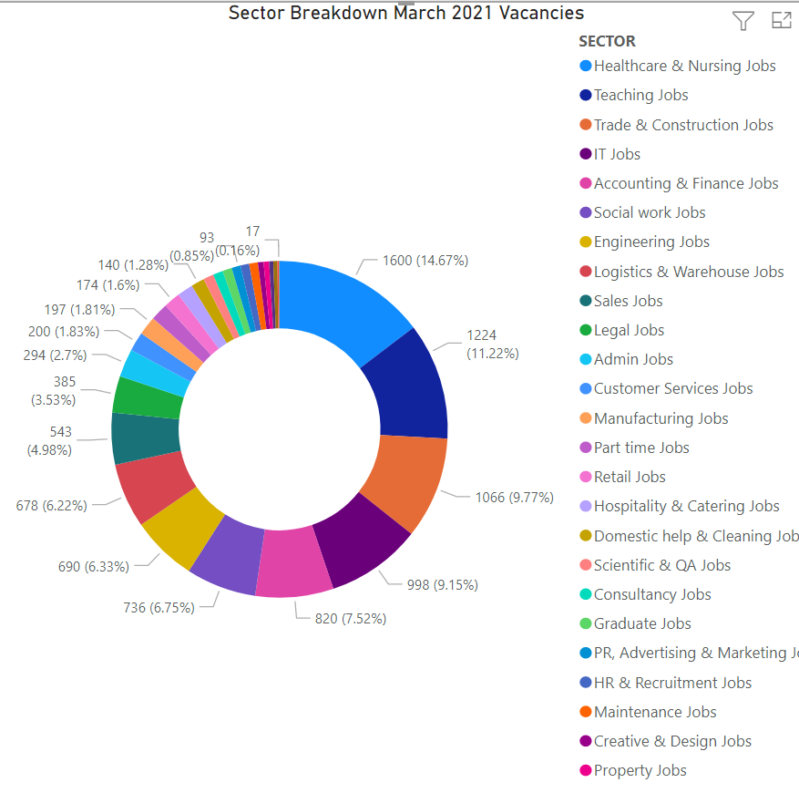
Job Vacancy Data – Sector Changes
In terms of actual volume of vacancies – this number fluctuates, but on average each month: Healthcare & Nursing lead with 14.6% (1,600), followed by Teaching 11.2% (1,224), Trade & Construction 9.7% (1066), IT Jobs 9.1% (998), Accounting & Finance 7.5% (820), Social Work (736) 6.7%, Engineering 6.3% (690) and Logistics & Warehouse Jobs 6.2% (678).
4

