Slide 1
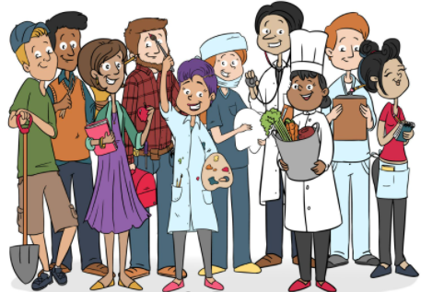
Humility
Justice
Compassion
Thankfulness
Hope
Service
Wisdom
Trust
Endurance
Forgiveness
Integrity
PSCHEE - Careers Education Session 1
Write today’s date.
Title: Introduction to Careers Education.
Task 1:
What is this months Christian value?
How does this Christian value link to our future careers?

Slide 2
Why is Careers Education important?
Task 1:
Write the above question into your exercise book.
In pairs discuss WHY it is important to receive good quality careers education.
Write your findings into your exercise book.
An example has been done for you.
Example:
Careers Education is important because it helps us to make informed decisions.

Slide 3
Add to your work in purple pen to show new learning.
It is important because it raises our aspirations.
It is important because it helps us to make choices.
It is important because it helps to inspire us.
It is important because it helps us understand the world of work.

Slide 4
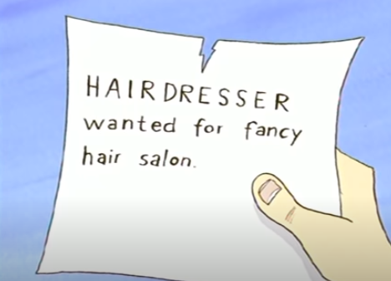
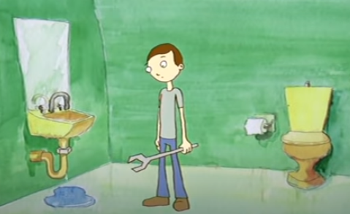
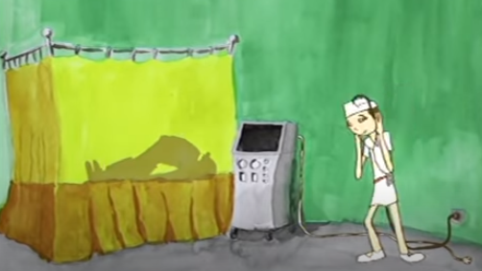
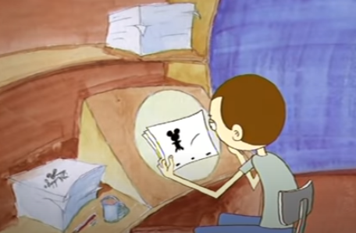
When thinking about a career there are different things we need to consider.
Watch the clip and answer the questions: https://www.youtube.com/watch?v=-VasGrFLqW8&t=14s
1. What did the boy do wrong when making his career choices?
2. What did he do right?
3. What do we learn from this?

Slide 5
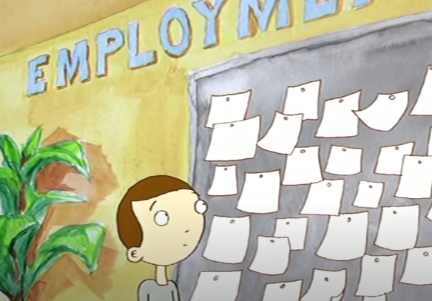
What do we learn about making career choices?
5. It is important to seek information and guidance on your chosen career. Learning is lifelong.
1. It is important to think carefully about our career path.
2. It is important to choose a career that we are interested in and will enjoy!
4. It is important to make the correct choices for GCSE.
3. It is important that we research our chosen career to find out what the entry requirements are and any promotion opportunities.

Slide 6
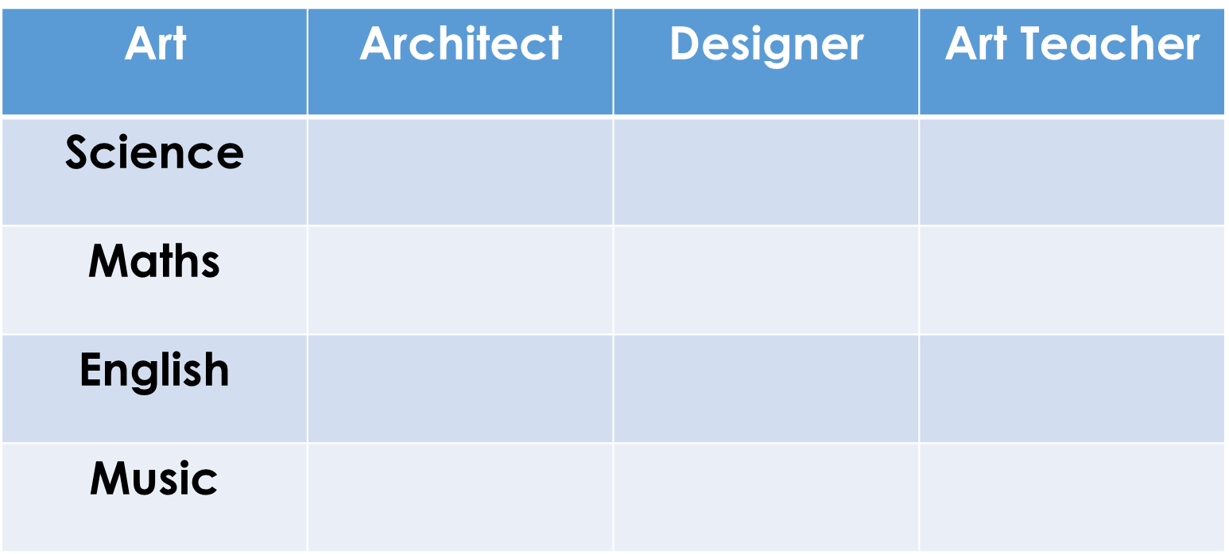
Watch the clip below – copy and complete the table into your exercise books. What jobs can the following subjects help you get access to?

Slide 7
PSCHEE - Careers Education Session 2
Write today’s date.
Title: Reflection of my gift and talents and how they will help my chosen career.

Slide 8
Task 2: What are my gifts and talents? How will these affect my chosen career?
Copy and complete the table below in your exercise book.
What are your top three career paths? (Jobs) | What do you consider to be your gifts or talents? (What are you good at?) | What do you consider to be your weaknesses? (What are you not good at?)
1.
2.
3.
Task 3 : Think – Do your gifts and talents help or hinder your top 3 chosen careers?
Write your comments into your book as shown below.
Example | Career path 1: Doctor | Talents – compassionate, caring | Weakness – Don’t like blood

Slide 9
Complete the activities below in your exercise books in full sentences.
What is your dream job? | Why is this your dream job?
What GCSE’s do you need in order to get this job? | Do you need to get higher level qualifications for this job?
Maths | English | Science | RS
Languages | Art | History | Geography
A Levels | Apprenticeship
University Education

Slide 10
Home research task:
Research your top 3 chosen careers.
Find out the following:
Is this career something that you will be good at and enjoy?
What qualifications do you need for this career? (GCSE’s/A-levels/Degree)
What personal qualities are required for this this career? (good communicator, good as part of a team?)
Are there opportunities in this career near where you live, or would you have to travel? Are you willing to travel?)
What is the starting salary?
Are there opportunities for promotion?
Do you know anyone already in this career?
Would voluntary work help you to stand out?
What type of references would you need for this career?
If you pursue this type of career, would you be willing to continue with professional development? Remember the benefits of being a lifelong learner!
Be ready to share your findings with the class in your next PSHCEE session.

Slide 11
PSCHEE - Careers Education Session 3
Write today’s date.
Title: Reflection of my gift and talents and how they will help my chosen career.

Slide 13
What skills and attributes do employer’s value?
Watch the clip (previous slide)
Complete the tasks below in your exercise book.
Task 1: Explain why exam results and qualifications are important to have? (What do they show?)
It is important to have good exam results because it shows potential employers that…
Task 2: What is the difference between hard skills and soft skills?
Hard skills are…
Soft skills are…
Task 3: What soft skills would you need to have for the following careers?
Nurse
Electrician
Teacher
Vet
Business Owner

Slide 14
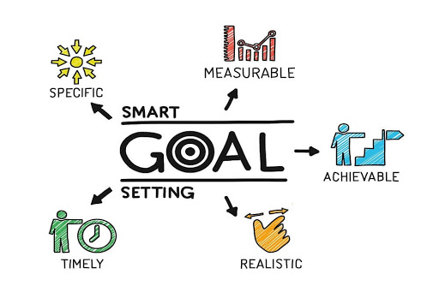
SMART Target/Goal Setting
What is SMART Target setting?
SMART is a mnemonic acronym, giving us criteria to guide us when setting goals.
When setting goals or targets for yourself they must be…
Specific (simple and sensible).
Measurable (meaningful, motivating).
Achievable (agreed, attainable, possible).
Realistic (reasonable, realistic)
Timely (time limit)

Slide 15
How to set SMART Targets…

Slide 16
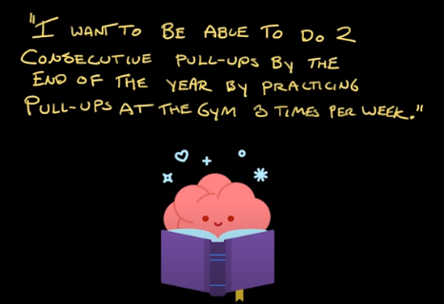
Independent written task….
Task:
Use Thinky Pinky’s example to help you set your own SMART Target.
Complete this in your exercise book.
1.Identify a target or a goal.
2. Explain HOW it is
SPECIFIC
MEASUREABLE
ACHIEVEABLE
REALISTIC
TIMELY

Slide 17
What opportunities are available to me when I complete KS3/KS4?
The first thing to remember about and thinking about your future is that you should aim high! When you set yourself a target/goal in life – it is possible.
However it will take hard work and commitment.
Aspire to be the best you can be.
At the end of KS3 | You will be asked to choose subjects to study at GCSE. Think carefully about these.
At the end of KS4 | You can choose from: Full time/Part time Education (A levels, T-Levels, NVQ’s, Btecs, access courses, apprenticeships, vocational subjects). Many local schools and colleges offer these. Work based learning such as an apprenticeship. Employment. Watch the clip: https://www.youtube.com/watch?v=f_xAQNNi4pA

